Slide 1
Intruder

Slide 2
One of the most important threats to security is an intruder generally referred to as ‘hacker’ or ‘cracker’
There are 3 classes of intruders
1.Masquerader
2.Misfeasor
3.Clandestine user
1.Masquerader:An individual who is not authorized to use the computer and who penetrates a system , access controls to exploit a legitimate user account
2.Misfeasor:A legitimate user who accesses data ,pgm etc for which such access is not authorized and also misuses his privileges

Slide 3
3.Clandestine user : An individual who seizes supervisory control of the system and uses this control to suppress the audit collection

Slide 4
Intrusion Detection
Inevitably will have security failures
so need also to detect intrusions so can
  block if detected quickly
  act as deterrent, so to prevent intrusions.
  collect info to improve security

Slide 5
Intrusion Detection
Approaches to intrusion detection
1.Statistical anomaly detection : Collection of data relating to the behavior of legitimate users over a period of time
a. Threshold detection: Involves defining threshold , independent of user , for the frequency of occurrence of various events
b. Profile based: Profile of the activity of each user is developed and used to detect changes in the behavior of individual accounts

Slide 6
2.Rule-Based Detection: Defines a set of rules that can be used to decide that a given behavior is that of an intruder
a. Anomaly Detection: Rules are developed to detect deviation from previous usage patterns.
b. Penetration Identification :An expert system approach that searches for suspicious behavior
Statistical approaches attempt to define normal or expected behavior , whereas rule-based approaches attempt to define proper behavior

Slide 7
Audit Records
Fundamental tool for intrusion detection
Record of ongoing activity by users must be maintained as input to an intrusion detection system
Two plans are used
Native Audit Records : Multiuser operating systems include accounting s/w that collects information on user activity
Advantage : No additional collection software is needed
Disadvantage: Native audit records may not contain the needed info or may not contain it in a convenient form

Slide 8
Detection-Specific Audit Records : A collection facility can be implemented that generates audit records containing only that information required by the intrusion detection system
Advantages : Vendor independent and ported to a variety of systems
Disadvantages : Extra overhead involved in having, in effect ,two accounting packages running on a machine
Audit Record Contains following fields:
Subject : Initiators of action . Subject is “ a terminal user “ but also be “a process acting on behalf of users” or group of users
Action: Operation performed by the subject on or with an object
Eg: login, read , perform I/o , execute

Slide 9
Object: Receptors of actions.
Eg: files, programs , messages
Exception Condition :Denotes any Exception condition raised on return
Resource-Usage : A list of quantitative elements in which each element gives the amount used of some resource
Eg: no: of lines printed ,number of records read or written
Time-Stamp: Unique time and date stamp identifying when the action took place

Slide 10
Statistical Anomaly Detection
Statistical Anomaly detection techniques fall into two broad categories:
  Threshold detection
  Profile based detection
  Threshold detection involves counting the number of occurrences of a specific event type over an interval of time .If the count surpasses a reasonable no: ,intrusion is assumed
  Profile based anomaly detection focuses on characterizing the past behavior of individual users or a related group of users and then detecting significant deviation

Slide 11
Profile Based detection intrusion are following:
Counter : A count of certain event types is kept over a particular period of time
Gauge : Used to measure the current value of some entity
Interval timer : Length of time between two related events
Resource Utilization : Quantity of resource consumed during a specified period
Advantage of statistical approach : Prior knowledge of security flaws is not required

Slide 12
Rule Based Intrusion Detection
observe events on system & apply rules to decide if activity is suspicious or not
Rule-based anomaly detection
  analyze historical audit records to identify usage of patterns & auto-generate rules for them
  then observe current behavior & match against rules to see if conforms
  like statistical anomaly detection does not require prior knowledge of security flaws

Slide 13
Rule-based penetration identification
  uses expert systems technology
  with rules identifying known penetration, weakness patterns, or suspicious behavior
  compare audit records or states against rules
  rules usually machine & O/S specific
  rules are generated by experts who interview & codify knowledge of security admins
  quality depends on how well this is done

Slide 14
Base-Rate Fallacy
practically an intrusion detection system needs to detect a substantial percentage of intrusions with few false alarms(Ie, by keeping the false alarm rate at an acceptable level),
  if too few intrusions detected -> false security
  if too many false alarms, ie if the s/m frequently triggers -> ignore / waste time
this is very hard to do
existing systems seem not to have a good record

Slide 15
Distributed Intrusion Detection
traditional focus is on single systems
but typically have networked systems
more effective defense has these working together to detect intrusions
issues
  dealing with varying audit record formats
  integrity & confidentiality of networked data
  centralized or decentralized architecture

Slide 16
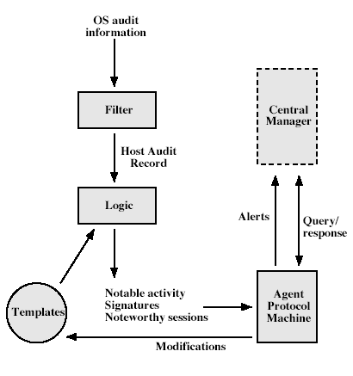
Distributed Intrusion Detection – Agent Implementation

Slide 17
Honeypots
decoy systems to lure attackers
  away from accessing critical systems
  to collect information of their activities
  to encourage attacker to stay on system so administrator can respond
are filled with fabricated information
instrumented to collect detailed information on attackers activities
single or multiple networked systems
cf IETF Intrusion Detection WG standards

Slide 18
Password Management
front-line defense against intruders
users supply both:
  login – determines privileges of that user
  password – to identify them
passwords often stored encrypted
  Unix uses multiple DES (variant with salt)
  more recent systems use crypto hash function
should protect password file on system

